Slide 1


HHR Analytics Report

Slide 2
NAME – TANUSHRI
EMAIL ID – tanushri2106@gmail.com
BATCH CODE – 17-Jul-23-CDA-BUN-040 -WDM11-BAN
PROJECT ID – PTID-CDA-OCT-23-055
PROJECT CODE – PRDA-03
PROJECT NAME – HR Analysis
DATE – 19/11/2023

Slide 3
INTRODUCTION
What is HR Analytics?
HR analytics is the process of collecting and analyzing Human Resource (HR) data in order to improve an organization’s workforce performance. The process can also be referred to as talent analytics, people analytics, or even workforce analytics.
This method of data analysis takes data that is routinely collected by HR and correlates it to HR and organizational objectives. Doing so provides measured evidence of how HR initiatives are contributing to the organization’s goals and strategies.

Slide 4
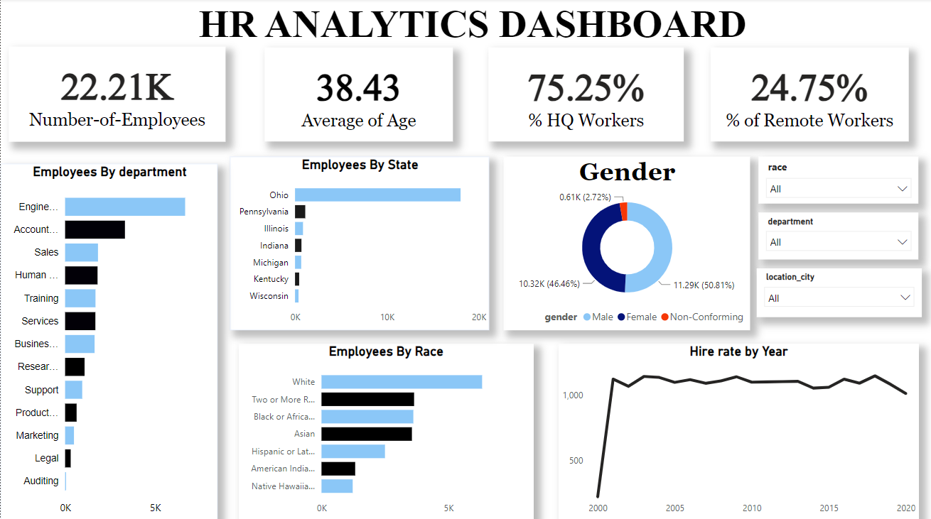

Slide 5
In this HR Analytics dashboard can provide valuable insights and benefits to organizations in many different areas, from talent acquisition and retention to workforce planning and diversity and inclusion. In this project I have measure every-thing as per HR analysis, in this project.
In this HR Analysis Dashboard we are using multiple types of graphs and filters for better analysis.

Slide 6
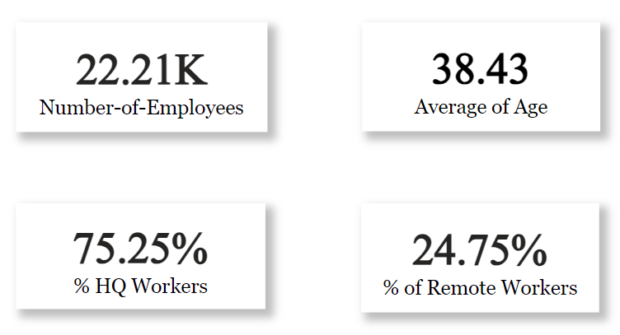
Key Indicator Point (KPIs)

Slide 7
KPIs show how many total employees there are in the company, what is the average age of the employees, how many employees in the company work from home and how many employees work from the office.

Slide 8
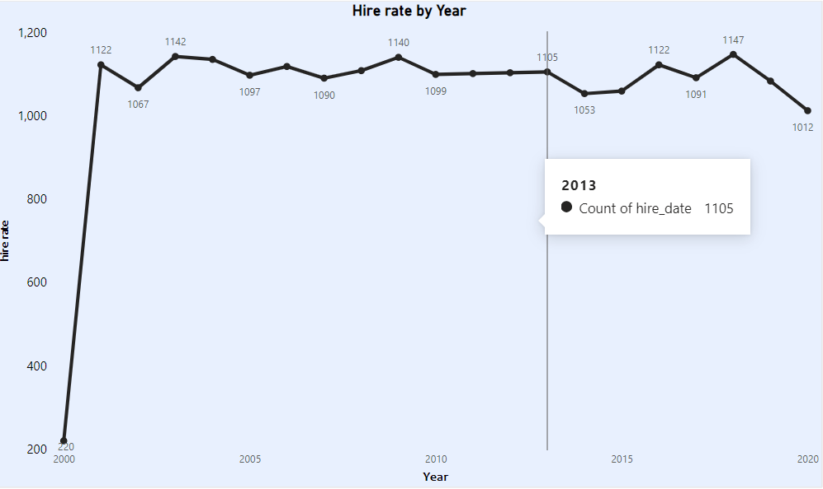
Line Chart Showing The Hiring Rate By Years

Slide 9
The line chart shows how many employees are hired by the company each year.

Slide 10
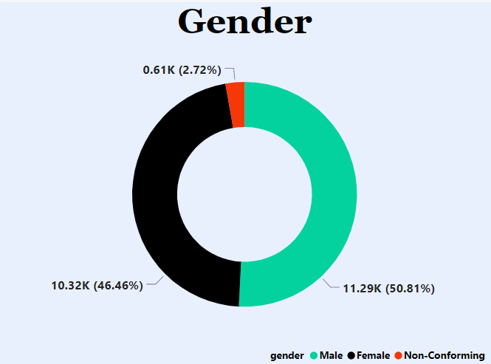
Donut Chart Representing The Gender of Employees

Slide 11
Donut chart shows how many male and female employees work in the company.

Slide 12
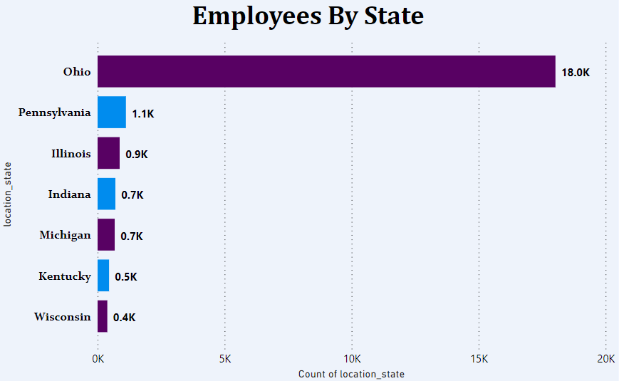
(A) Bar Charts Showing Employees By State

Slide 13
This chart shows how many employees are from which state and from which state the maximum and minimum number of employees are employed in the company.

Slide 14
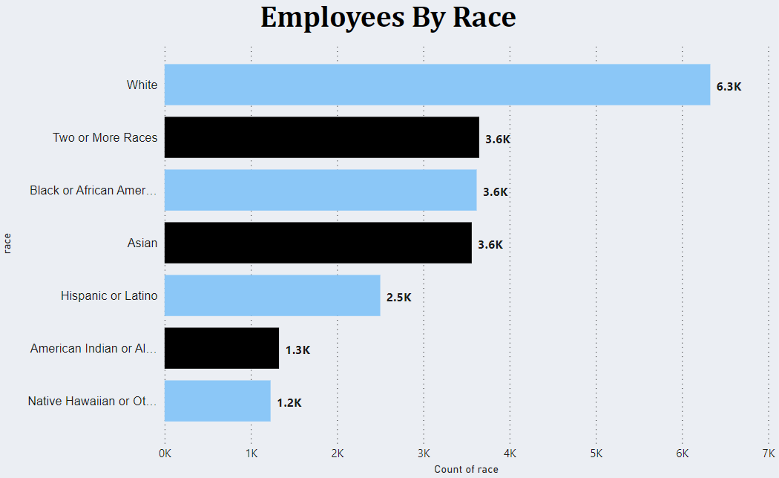
(B) Bar Charts Showing Employees By Race

Slide 15
This bar chart shows which race of employees are working in our company.

Slide 16
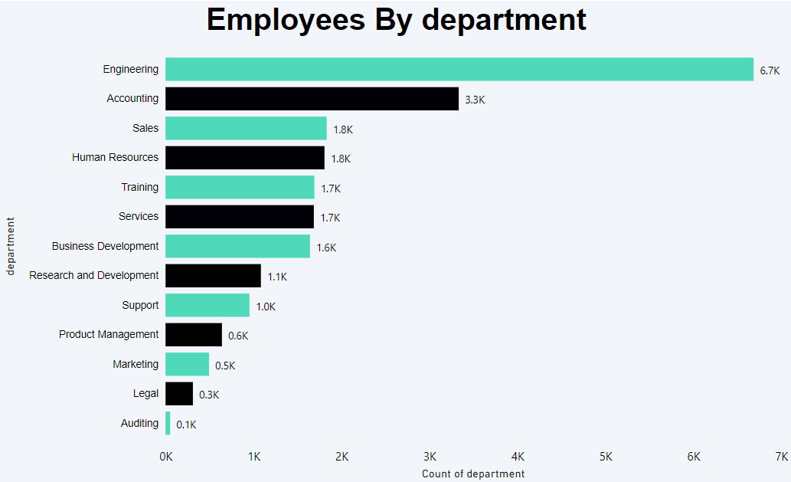
(C) Bar Charts Showing Employees By Department

Slide 17
This bar chart shows how many employees work in which department of the company and which department has the most and least employees.

Slide 18
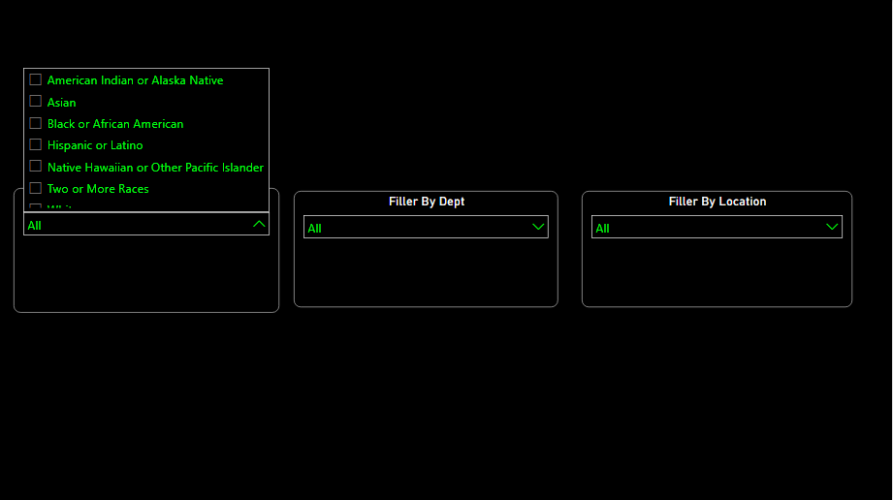
Dashboard Filters

Slide 19
In this Dashboard I am using 3 Filters like
Filter By Department
Filter By Race
Filter By Locations
This Filter will help to Deep analysis and decision making

Slide 20
INSIGHTS & INPUTS/SUGGESTIONS TO THE COMPANY

Slide 21
Insights
1) HQ Workers are more than remote workers
2) Engineering department has more employees as compared to other departments
3) 2001 has highest higher rate
4) Male employees are more in number whose age is greater then -50

Slide 22
Inputs /Suggestions to the Company
1) Hire even more other departments to the company
2) Even other states should get opportunity to work in this company

Slide 23
Thank you
THANK YOU

